Slide 1

VISUALIZATION OF DATA
Thanh Duy KHONG​

Slide 2
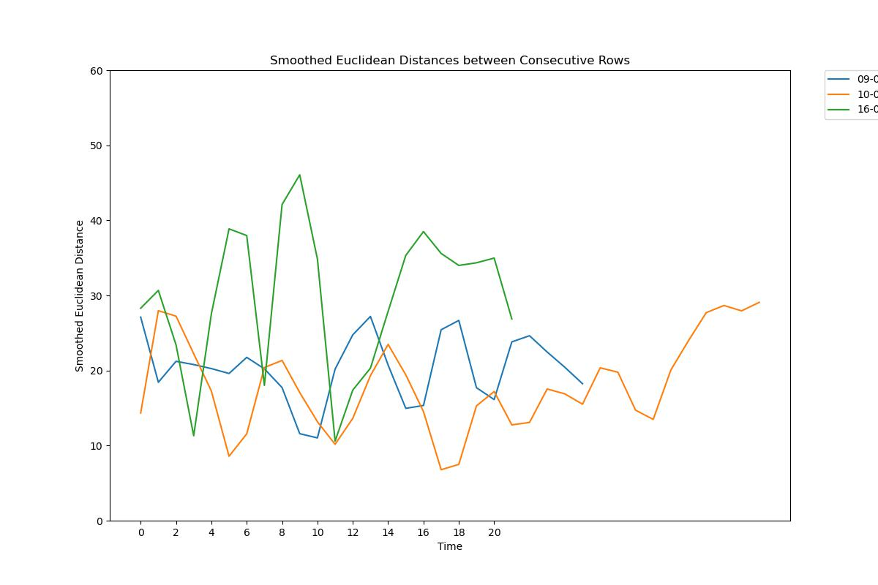
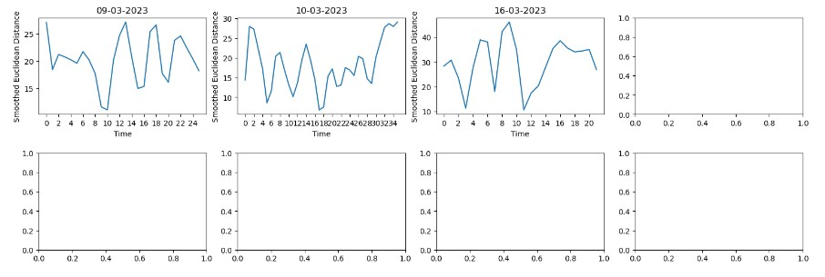
Graph of BAYU

Slide 3
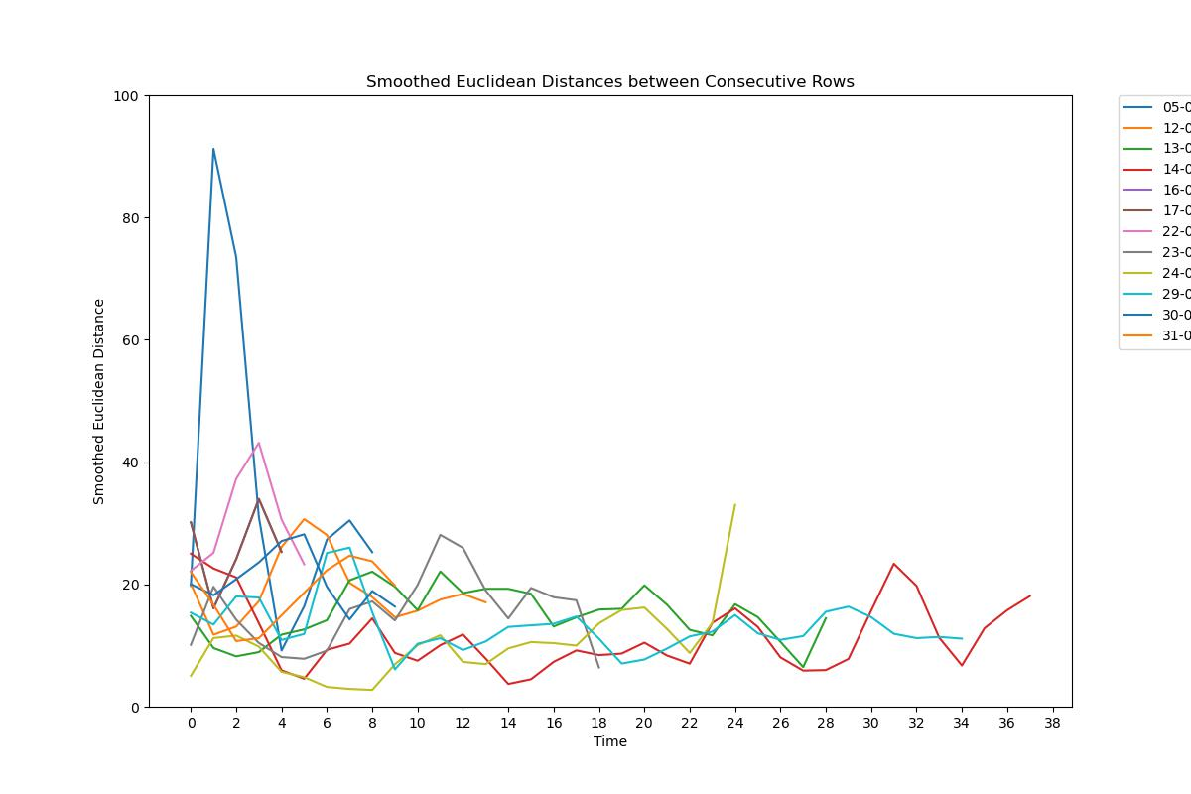
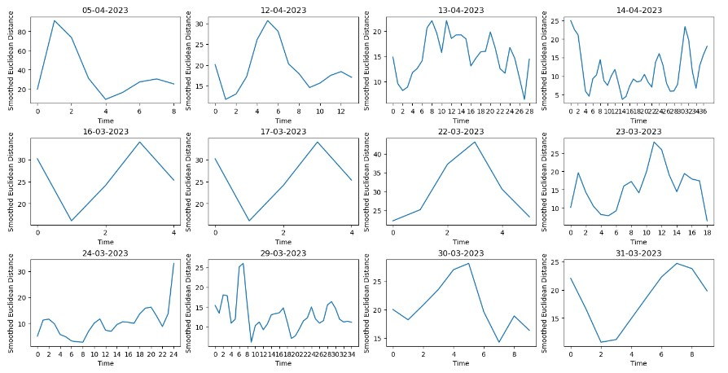
GRAPH OF ELENA

Slide 4
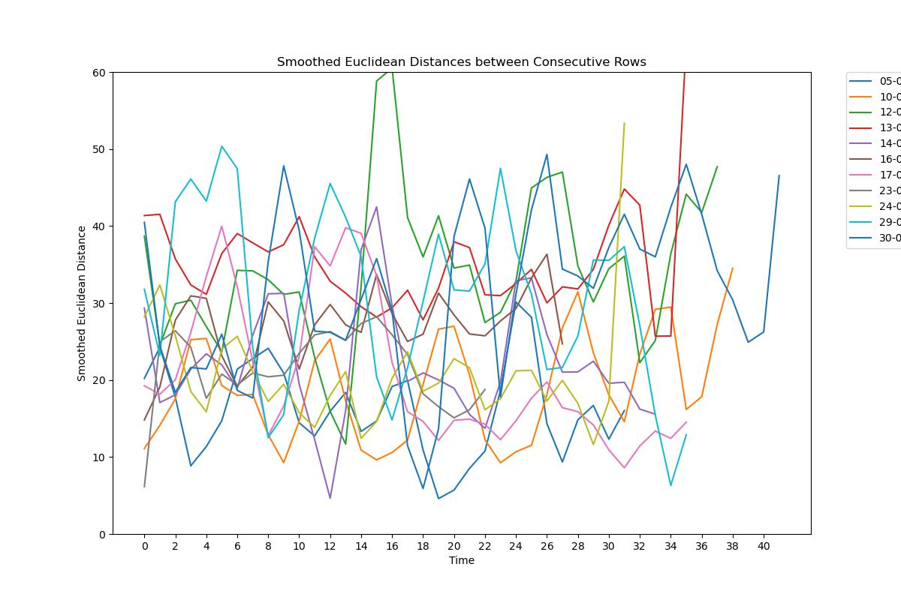
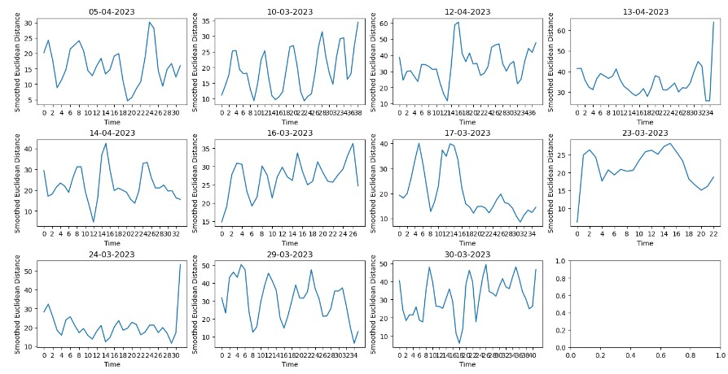
GRAPH OF micheal

Slide 5
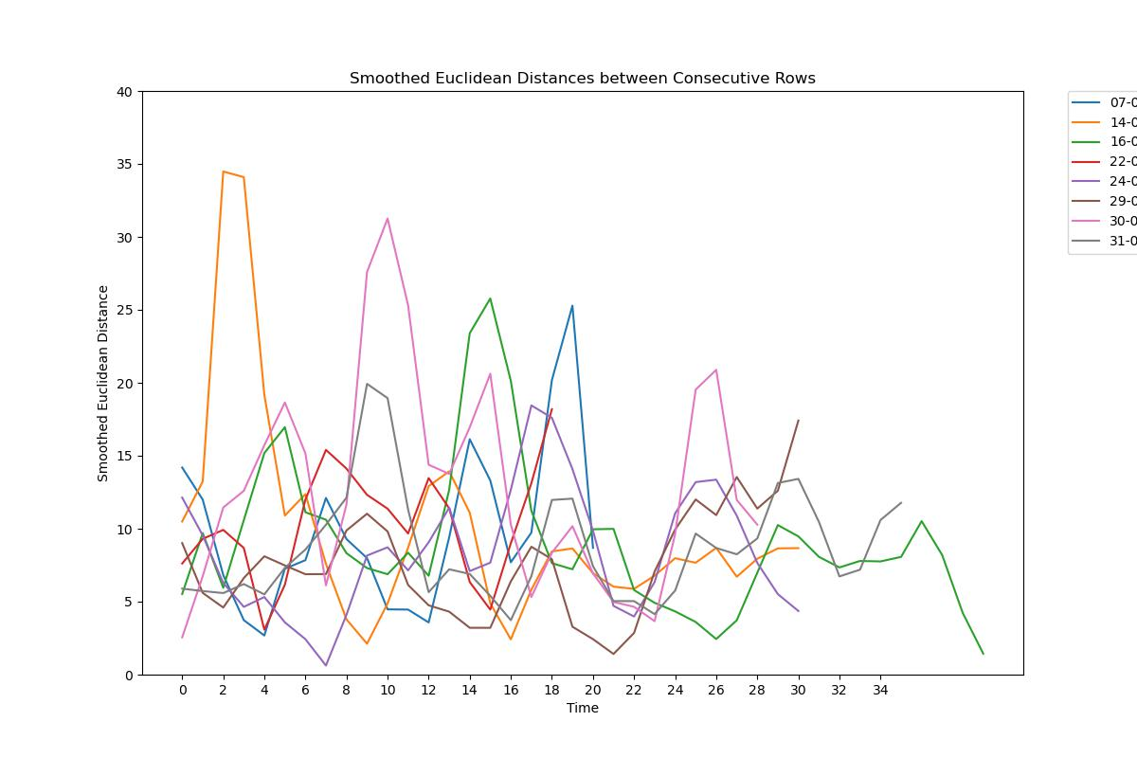
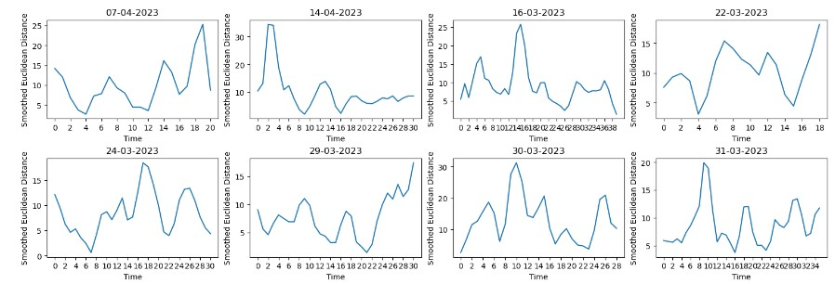
Graph of TAMILY

Slide 6
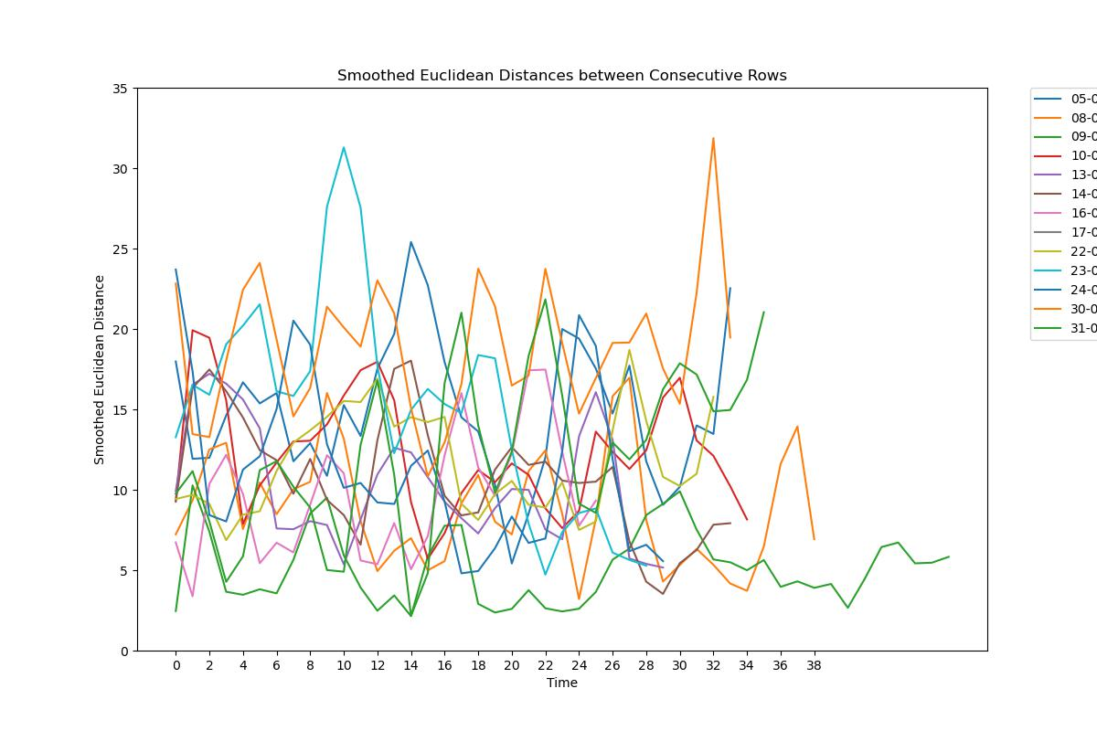
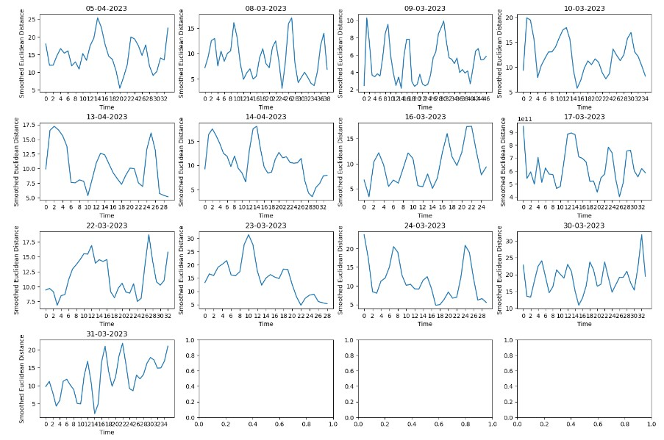
GRAPH OF YELIZ

Slide 7


Merci
Mirjam Nilsson​
mirjam@contoso.com | www.contoso.com

